Slide 1
ENHANCING CONCRETE STRUCTURAL DESIGN: PREDICTIVE MODELING FOR TENSILE STRENGTH EVALUATION
Nelly Nkirote E033-01-2339/2020
Joseph Gathithi Wathome E033-01-1386/2020
Supervisor
Dr. ERASTUS KAROKI

Slide 2
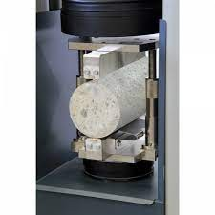
INTRODUCTION
Predict concrete strength using PyTorch.
Consider cement type, water content, admixture,
curing time, and aggregates.
Model tested on 20% data and extra lab samples.
Aim is to enhance civil engineering practices.
Split Tensile Testing

Slide 3
PROBLEM STATEMENT
This project proposes a Python-based neural network model to predict concrete's tensile strength, aiming to enhance efficiency and accuracy in civil engineering practices.
GENERAL OBJECTIVE
Develop a Python-based neural network model using PyTorch to accurately predict concrete tensile strength in civil engineering application.
Notes:
2 STATEMENT OF THE PROBLEM
The tensile strength of concrete is critical for the durability and integrity of structures. However, current methods to determine this are labor-intensive, time-consuming, and may lack precision. Additionally, it’s a misconception that high compressive strength guarantees high tensile strength. This project proposes to develop a Python-based neural network model to accurately predict concrete’s tensile strength, aiming to reduce testing time and costs, and enhance the efficiency of ensuring the quality and durability of concrete structures.

Slide 4
SPECIFIC OBJECTIVES
Consolidate essential parameters including cement type, curing duration, aggregate size, water content, and types of admixtures
Construct and train a PyTorch neural network model specifically tailored to predict concrete tensile strength
Test the model with 20% data and three lab datasets, compare outputs with lab results, and refine accuracy by adjusting nodes, layers, weights, and biases

Slide 5
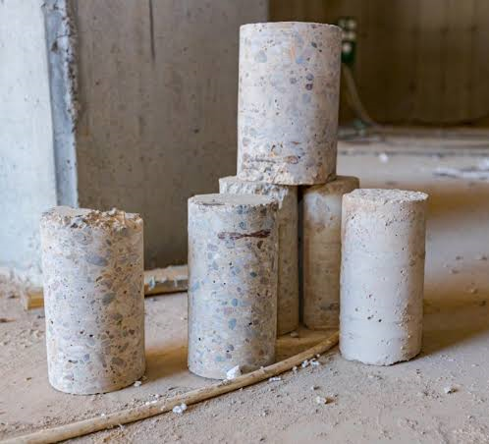
RESEARCH GAP
Limited Research in Kenya
Need for More Accurate Predictions
Need for Real-World Validation
Sample Examples

Slide 6
METHODOLOGY
Data Collection & Processing
Feature Selection
Model Development (Tensile Predictor)
Loss Function
& Model Optimization
Training Process
Evaluation Process
Model Refinement & Saving
Documentation & Reporting

Slide 7
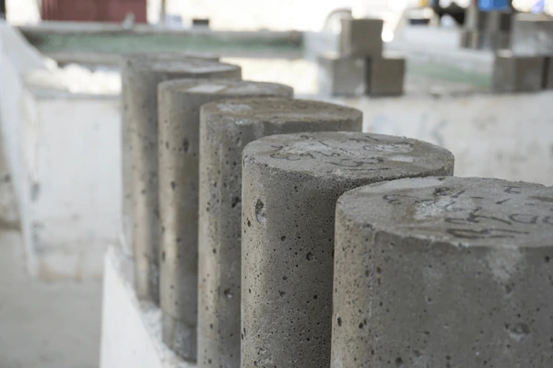
METHODOLOGY
DATA COLLECTION & PROCESSING
Prepare, cure, and test concrete samples with varying parameters, recording the features and tensile strength for each of the 81 combinations.
Preprocess and partition the collected data for use in a neural network model.

Slide 8
METHODOLOGY
FEATURE SELECTION
Refine key parameters like cement-water proportions, cement type, aggregate size, admixtures and curing duration.
Apply normalization and scaling techniques to these features for optimal model integration.

Slide 9
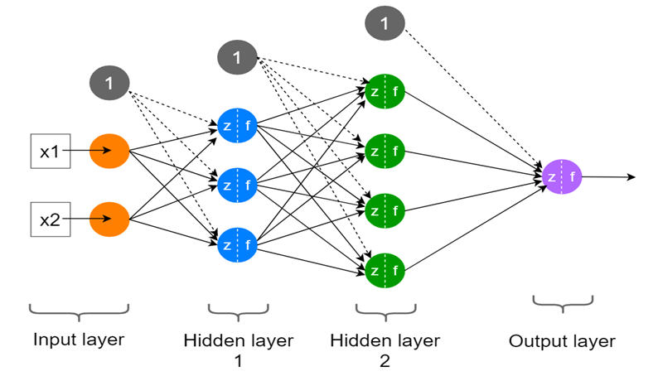
METHODOLOGY
MODEL DEVELOPMENT (TENSILE PREDICTOR)
Creating a PyTorch model to estimate concrete's tensile strength.
Adjusting the model’s layers and nodes for accurate predictions.
Notes:
loss function, like Mean Squared Error or Mean Absolute Error

Slide 10
METHODOLOGY
LOSS FUNCTION & MODEL OPTIMIZATION
Using a loss function and gradient descent to measure and minimize prediction errors.
TRAINING PROCESS
80% of the data is used to teach the model with adjustments for error minimization and a validation set for generalization.

Slide 11
METHODOLOGY
EVALUATION PROCESS
Post-training, the model is tested on 20% of the data and further evaluated with additional lab samples.
MODEL REFINEMENT & SAVING
After testing, the model is refined and optimized, then the best version is saved for future use.
DOCUMENTATION & REPORTING
All project steps and results will be fully documented.
A comprehensive report summarizing the methodologies and findings will be prepared.

Slide 12
FEATURE SELECTION
Cement Type | Admixture | Cement-Water Ratio | Aggregate Size
OPC | Air-Entraining | 0.45 | 5mm
KP Silver | Rapid Hardening | 0.50 | 10mm
Quick Setting | Accelerating | 0.60 | 20mm
81 LAB SAMPLES

Slide 13
Expected Outcome
Prepare 81 samples for testing through split testing.
Process the collected data to build the model.

Slide 14
THE END

